Slide 1
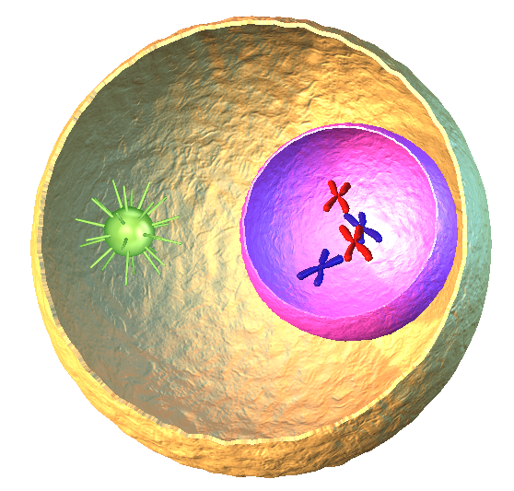

130 min
Middle School
Grades: 6 - 8
CCSS, NGSS
INTRO TO ARTIFICIAL INTELLIGENCE -PROJECT
Predictive Pancreas;
Harnessing AI for Diabetes Risk Assessment
Rupesh Kumar Dhanala(00869260)

Slide 2

PROJECT OVERVIEW
'Predictive Pancreas,' a groundbreaking project that delves into the realm of artificial intelligence to revolutionize diabetes risk assessment."
Significance of Diabetes
Diabetes, a prevalent global health concern, requires early detection for effective management and prevention. 'Predictive Pancreas' seeks to contribute to this endeavor by leveraging AI technologies
Objective
My primary goal is to develop an advanced predictive model that utilizes machine learning to assess an individual's risk of developing diabetes. This model takes into account a range of health indicators for a holistic approach to risk assessment.
.
.
.
.

Slide 3
Motivation
The motivation behind 'Predictive Pancreas' lies in its potential to impact public health positively. Early identification of diabetes risk enables timely interventions, fostering a healthier society.
Challenges Addressed
I’m address the challenges associated with early diabetes risk assessment, aiming to provide a scalable and reliable solution through the power of artificial intelligence
Importance of Early Detection
Early detection of diabetes is crucial for implementing preventive measures and lifestyle modifications. 'Predictive Pancreas' strives to empower individuals and healthcare providers with timely and accurate risk assessment
T

Slide 4
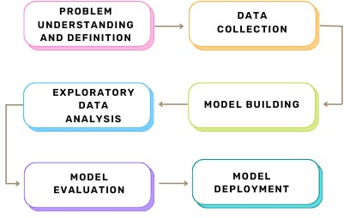














Approach

Slide 5
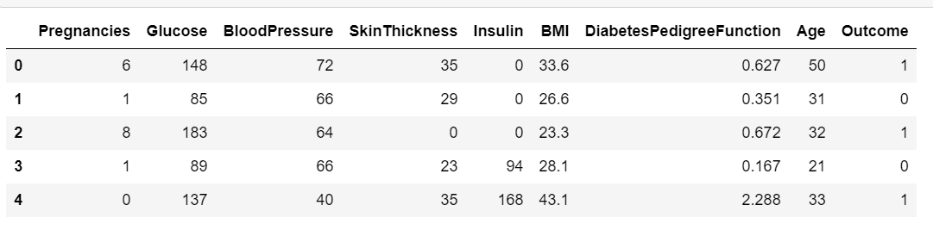
Data Collection
A comprehensive dataset has been collected from Kaggle.com
The key health indicators considered are gender, BMI, blood pressure , Age , Insulin etc.,.
Sample Dataset

Slide 6



Model Selection and Training
Split the dataset into training and testing sets.
Processing the dataset by making necessary adjustments to hyperparameters for optimal performance.
Train and evaluate the model and deploy the model with highest accuracy.
Prediction Algorithms
Method -1
Random Forest Algorithms Followed by two methods.
Random Forest Classifier .
Method-2
Random Forest Regressor.
Model Evaluation
Evaluating the model's performance using metrics such as accuracy, precision, recall, and F1 score.
Assessing the model's ability to predict diabetes risk and identify individuals at higher risk.

Slide 7
Tools and Libraries:
Python ,Jupyter Notebook
Scikit-learn, TensorFlow, or PyTorch
Pandas and NumPy
Matplotlib and Seaborn
This project title suggests a comprehensive approach to predicting diabetes risk using AI, emphasizing the early assessment for preventive measures.

Slide 8


